Slide 1



Tactical Detection & Data Analytics Summit
Save the Date: December 4-11 Scottsdale, Arizona
sans.org/summit
SEC599 – Defeating Advanced Adversaries
SEC530 – Defensible Security Architecture
SEC555 – SIEM with Tactical Analytics
SEC511 – Continuous Monitoring & Security Operations
SIEM NetWars
SUMMIT
Dec. 4-5
TRAINING
Dec. 6-11
sans.org/summit
Notes:
Drag Picture and Send to Back

Slide 2
Webcast
High Fidelity Alerts Alerts vs. Anomaly A Sibling Rivalry
Justin Henderson (@SecurityMapper) & Tim Garcia (@tbg911)

Slide 3


About Us
Justin Henderson | @SecurityMapper
SEC555/SEC530/SEC455 Author & Instructor
GIAC GSE # 108, Cyber Guardian Blue and Red
60 industry certifications (need to get a new hobby)
Tim Garcia| @tbg911
Information Security Engineer
SANS Certified Instructor Cyber Defense curriculum (SEC 301, 401, 501, 511, and 555)

Slide 4
Welcome!
A copy of this talk is available at: https://github.com/HASecuritySolutions/Presentations
More free stuff: https://github.com/HASecuritySolutions

Slide 5



Comparing Alerts vs. Anomalies
Alert - "a warning or alarm of an impending… attack"
~ dictionary.com
Anomaly - "an odd, peculiar, or strange condition…"
~ dictionary.com
What then would a new local admin account creation be?
DITD01
Administrator - Previously existed Temp123 - New local account
or

Slide 6
Business Context
What if you knew the following?
DITD01 = Desktop, IT, Development machine, # 01
Temp123 = Service account
Machine tests bulk application installations
An alert would equal a false positive
Must be tuned for alerts to remain useful
An anomaly would equal a false positive
False positives are more natural to an anomaly engine

Slide 7
Comparison
Alert
Anomaly
Purpose-built tactical rules
Intent is to find evil
But not create a false positive
Requires knowledge of self
Requires routine updates
Generally speaking an alert on its own needs investigated
Automated logic checks
Find abnormalities/deviations
False positives are normal
Possible to clean up but even more time consuming
No prior knowledge required
Combination of anomalies can become an alert

Slide 8
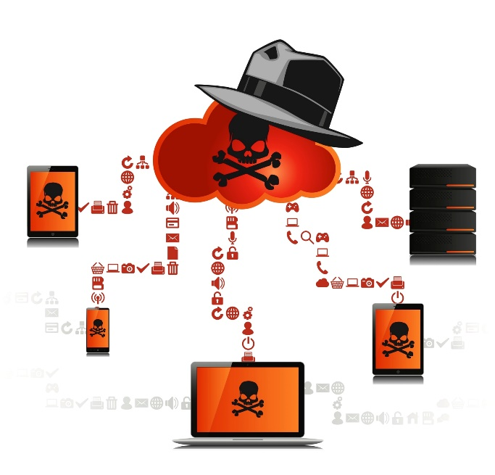
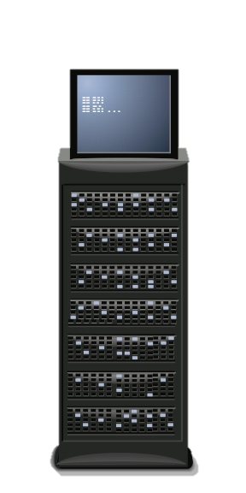


HTTPS Attack Scenario
Alerts Phishing domain Unknown PS cmdlets Unknown User-agent
DNS
Anomalies
New DNS domain
# of connections
Combined score?
PowerShell C2 to 1abmeinc.com via HTTPS

Slide 9
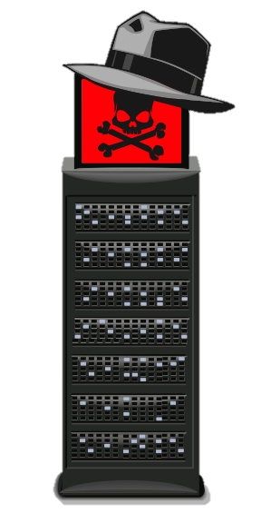
DNS Attack Scenario
Alerts Phishing domain Unknown PS cmdlets Unknown User-agent DNS Clipping level
DNS
Authorized DNS
Authorized DNS
Anomalies
New DNS domain
# of connections
Odd DNS use
Combined score
PowerShell C2 to 1abmeinc.com via DNS

Slide 10
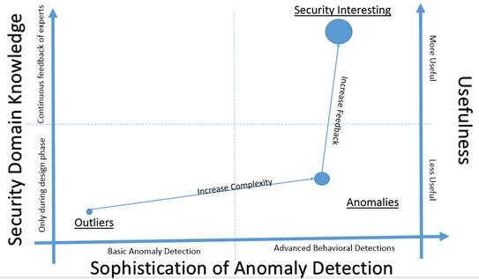
Domain Expertise and Anomaly Detection
"Evolution of Useful Results from Anomaly Detection Systems" Per Microsoft blog written by Thomas W Shinder¹
Notes:
https://blogs.msdn.microsoft.com/azuresecurity/2016/03/09/evolution-of-useful-results-from-anomaly-detection-systems/

Slide 11

Defining the Problem
You may have purchased: - SIEM, EDR, UBA, or UEBA
None come with domain expertise
Clarification - Commercial solutions have alerts and analytics that are based on domain expertise…
But not based on your environment
And not based upon the input of your staff's expertise
So the toy you just bought is missing batteries

Slide 12

Where to Invest Your Time
Alerts and anomaly detection both work
But both require tuning the out-of-the-box experience
Question is which is better to start with (alerts vs. anomalies)

Slide 13

Complexity
Complexity is the enemy of security
Would it be better to implement a NGFW with application control, IPS, AV, DLP, SSL inspection, and more or…
Start with layer 3 and 4 rules then revisit above?

Slide 14

Another Anomaly Example
People tend to be creatures of habit
Wake up around the same time
Eat similar foods
Drink similar drinks
Go to bed at similar times
Type of pattern can be used to identify anomalous activity
Greater level of deviation = Greater likelihood of anomaly (combinations may act as force multiplier)

Slide 15
Another Alert Example
Someone having intense chest pressure should go to the hospital (potential heart attack)
Observed condition is important enough to react to
There are basic things to look for with your detection solution
Brute force logins and password spraying
Logs being cleared
Randomly generated executables, domains, and services
List goes on…

Slide 16
Potential Order of Operations
Organizational maturity should guide decision making
Initial detection should start with easy win alerts
Eliminate time wasting false positives by tuning alerts
Audit alerts to verify they trigger appropriately
Start applying domain expertise to anomaly engine
Audit anomaly detection by running red team tests
Enter continuous improvement loop

Slide 17
Domain Expertise and Anomaly Detection
"Evolution of Useful Results from Anomaly Detection Systems" Per Microsoft blog written by Thomas W Shinder¹
Notes:
https://blogs.msdn.microsoft.com/azuresecurity/2016/03/09/evolution-of-useful-results-from-anomaly-detection-systems/

Slide 18

Mature Anomaly Detection
Desktop is compromised and uses unknown C2
Anomaly engine classifies as high abnormality based on
Timing of process offsets and patterns
# of network connections and directionality
Anomaly engine does not trigger on
Asset management software that looks similar to above
Authorized VPN activity
Business processes that have high abnormalities

Slide 19
Summary
Anomalies are deviations from normal conditions
Not all anomalies are evil
Anomalies require further investigation (suspicious, malicious, benign)
Alerts are those deviations and other things you believe to be evil
Can be generated from Anomalies
Can be generated from domain expertise and know thyself

Slide 20
Tactical Detection & Data Analytics Summit
Save the Date: December 4-11 Scottsdale, Arizona
sans.org/summit
SEC599 – Defeating Advanced Adversaries
SEC530 – Defensible Security Architecture
SEC555 – SIEM with Tactical Analytics
SEC511 – Continuous Monitoring & Security Operations
SIEM NetWars
SUMMIT
Dec. 4-5
TRAINING
Dec. 6-11
sans.org/summit
Notes:
Drag Picture and Send to Back

